Slide 1
Working with Data in C# Part A
Database Application Development
Lecturer: Garry singh
Manukau Institute of Technology

Slide 2
Databases
For small applications, you can use text files to store data for later processing.
However, as the data needs increase, it becomes more difficult to manage or relate data that is stored in flat text files.
This is where databases come into play.
Databases store information in records, fields, and tables.
You can think of a database as an electronic version of a filing cabinet, organized so that you can retrieve and use the data.

Slide 3
Database Management System (DBMS)
The computer programs that are used to manage and query a database are known as the database management system (DBMS).
They facilitate storage, retrieval, manipulation, and reporting of large amounts of data.
Example of relational DBMSs: Microsoft Access, Microsoft SQL Server, MySQL, Oracle, DB2.
Many of these DBMSs store data in tabular format and are considered relational databases.

Slide 4
Database Management System (DBMS) Fields and Records and Tables
In a relational database, the rows in the table are referred to as records and the columns are the fields of the table.
A field is a single piece of information, such as StudentID or FirstName.
A record is a complete set of fields.
When you have the student identification number, student last name, student first name, phone number, and so on about an individual student, this represents a student record.

Slide 5
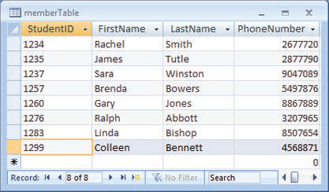
Database Management System (DBMS) Fields and Records and Tables
A table
A field
A record

Slide 6
Database Management System (DBMS) SQL
Structured Query Language (SQL) includes statements to access, manipulate, and update data in a database.
Using SQL queries, you can access single rows, all rows that meet some criteria, or all rows from one or more tables.

Slide 7
ADO.NET
ADO.NET consists of a managed set of library classes that allow you to interact with databases.
You use ADO.NET classes to retrieve and update data in databases, such as those created using Microsoft Access or SQL Server.

Slide 8
Interacting with Databases
Note: If the database is not created, you need to create it first!
Connecting to database
Retrieving the data (if required)
Processing the data
Updating the data (if required)
Closing the connection

